Slide 1






...........
PRESENTATION - 2024
CUSTOMER
DATA MANAGEMENT AND ANALYSIS
..............

Slide 2

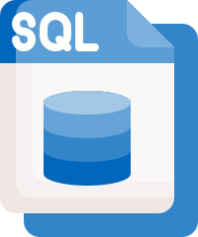







Data Pipeline
Data Sources
Schema
Data Warehouse
AZURE Data Studio
Monitoring
Deployment
Forcasting model
EDA

Slide 3




overview
Week 1:
Week 2:
Week 3:
Week 4:
Data Management and SQL Database Setup You’ll focus on designing the database, managing customer information, and interactions. This ensures that your data foundation is solid for future analysis.
Deliverables include a populated SQL database and basic SQL queries for extracting and analyzing customer data.
Data Warehousing and Python Programming
You’ll implement a SQL Data Warehouse to handle large-scale customer data for analytical purposes, then use Python for data extraction and preparation.
Deliverables: A functioning data warehouse and Python scripts..
Data Science and Azure Integration
In this week, you’ll dive into data science by performing Forcasting prediction and integrating Azure services for efficient data management.
Deliverables: Predictive models and a setup for Azure Data services.
You deployed the forecasting model using Streamlit, creating an interactive web app where users can input data and view forecast results. The final deliverables included the deployed Streamlit app and a comprehensive final report and presentation summarizing the key stages of your project: data management, analysis, and deployment.

Slide 4

Week 1

Slide 5
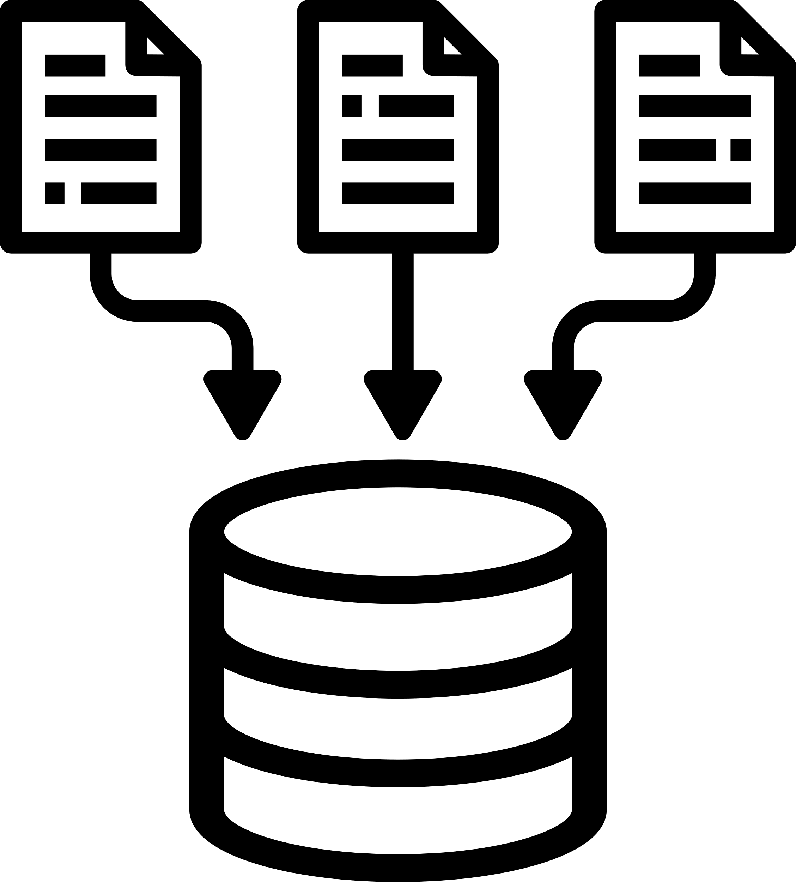
1. Database Design
Focus: Designing a robust SQL database schema to effectively manage customer data. This schema will handle everything from customer details to interactions, providing a solid foundation for future data analysis and reporting.
Key Message: A well-designed database is the cornerstone of effective customer data management, ensuring data consistency, integrity, and scalability.

Slide 6
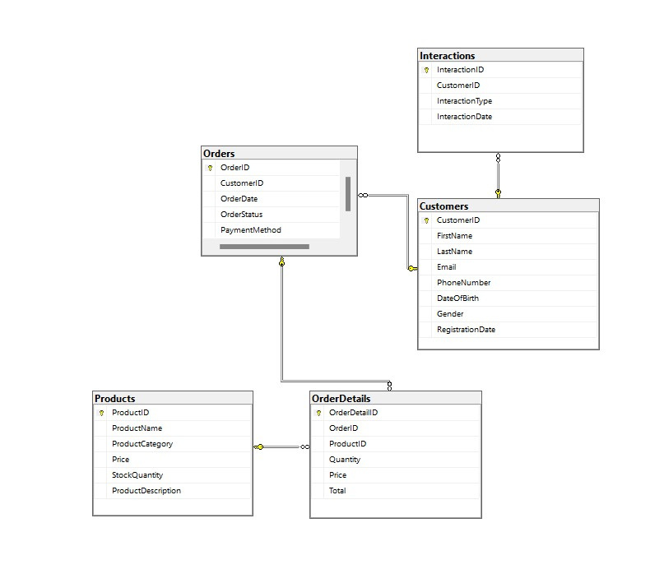
2. SQL Database Implementation
Focus: Using Microsoft SQL Server to create and populate a fully functioning database. This includes setting up the necessary tables and relationships for handling complex customer datasets.
Key Message: Leverage SQL Server's powerful capabilities to manage large volumes of customer data efficiently, ensuring that all information is organized and accessible for future analysis.

Slide 7

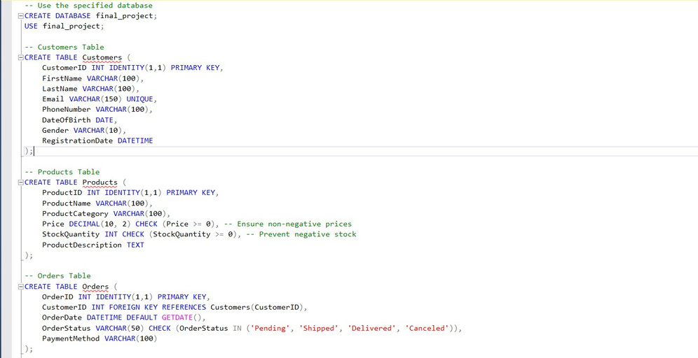
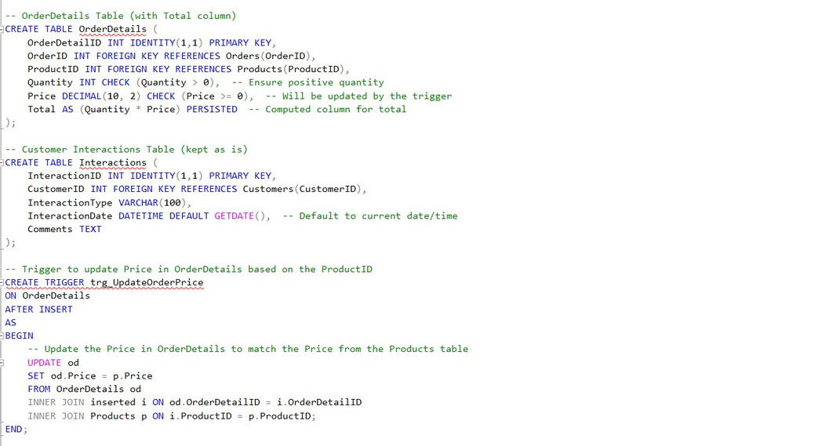

2. SQL Database Implementation
csv file for database source and our database backup:
https://drive.google.com/drive/folders/1Bf0BKbl9-pbQQwHlUbiPdvwyiWV7guEF?usp=sharing

Slide 8

3. SQL Queries for Data Extraction and Analysis
Focus: Writing optimized SQL queries to extract, update, and analyze customer data. These queries will allow for detailed reporting on customer behavior, transaction history, and interaction patterns.
Key Message: By developing well-structured queries, the project will enable quick insights into customer data, supporting business decisions and enhancing customer relationship management (CRM).

Slide 9
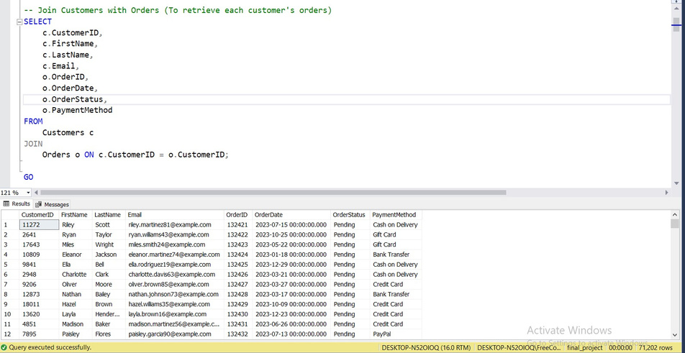
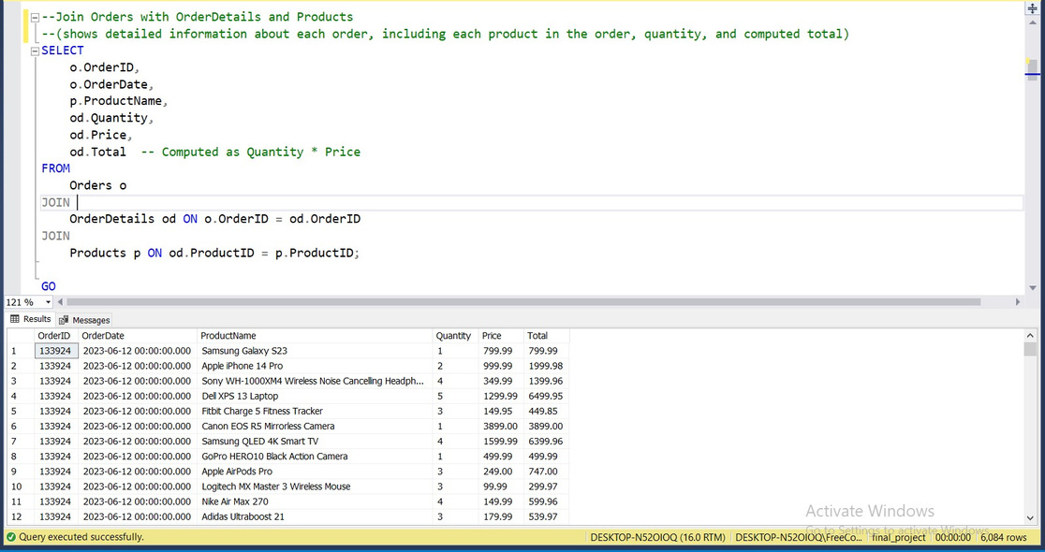
3. SQL Queries for Data Extraction and Analysis
retrieve each customer's orders
shows detailed information about each order

Slide 10
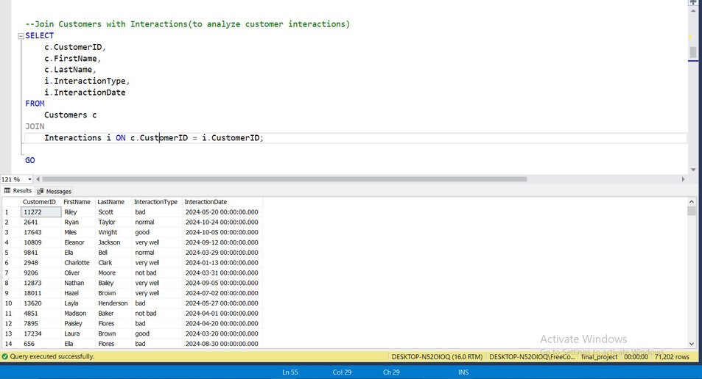
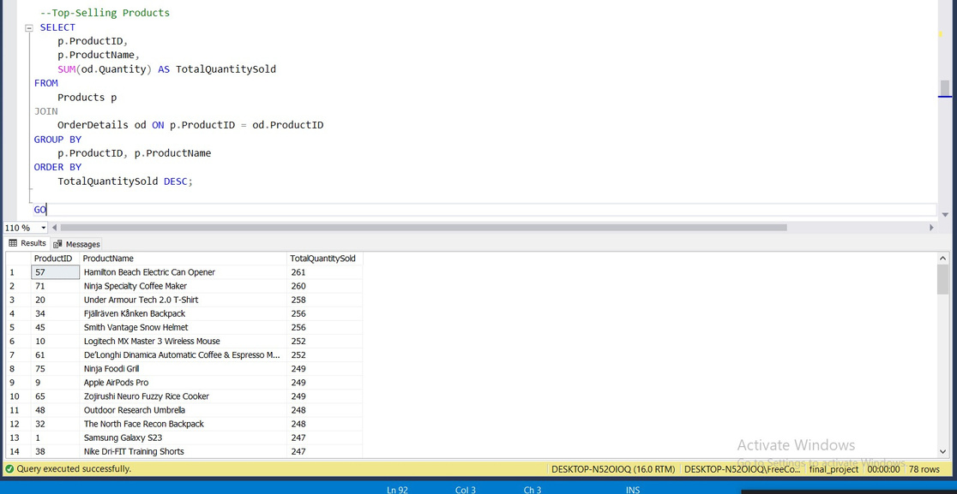
3. SQL Queries for Data Extraction and Analysis
analyze customer interactions
Top-Selling Products

Slide 11
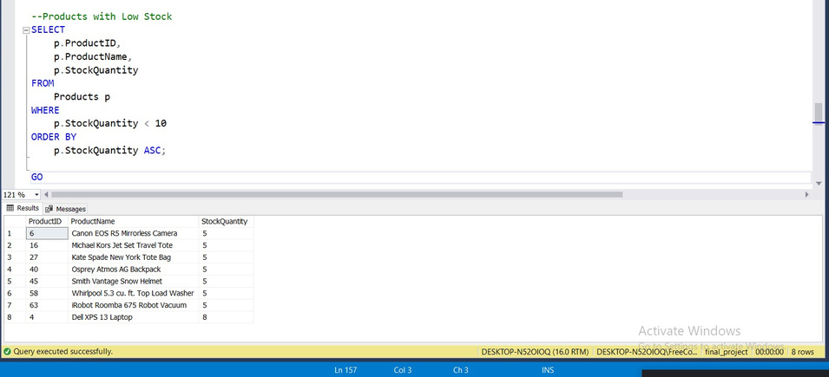
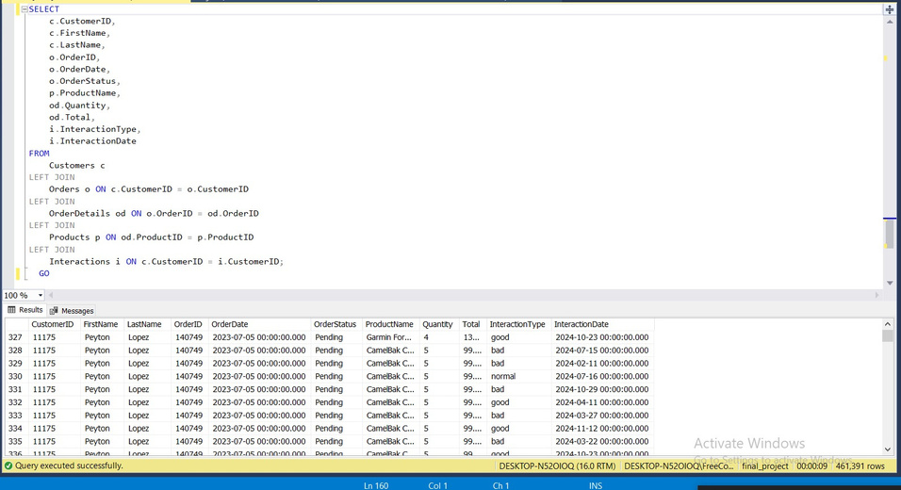
3. SQL Queries for Data Extraction and Analysis
To create a complete report including customer details, orders, products, and interaction history
Products with Low Stock
script for some sql queries (extraction and analysis)
https://drive.google.com/file/d/1QmNZuBP3NZkXa9VRVWElgseNM_YA2rP9/view?usp=sharing

Slide 12
Week 2

Slide 13

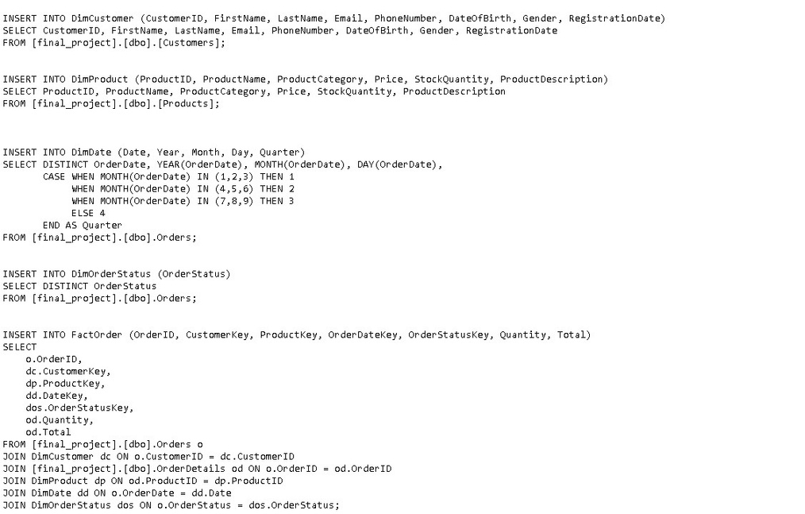
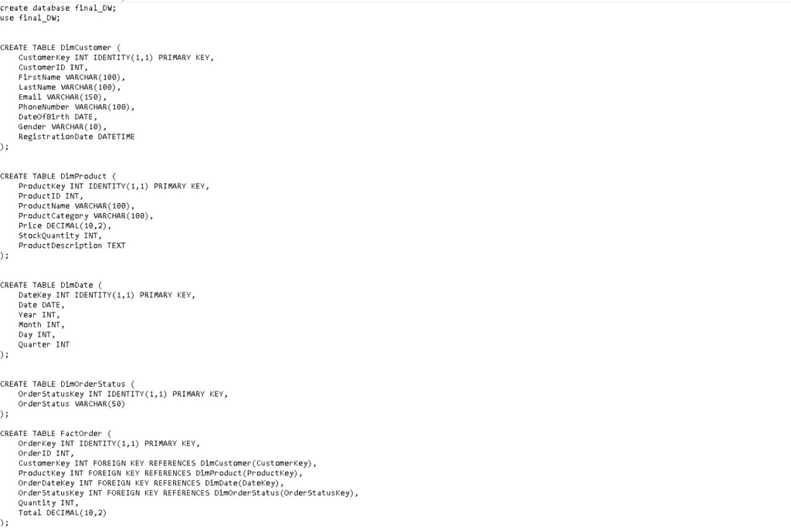
1. Data Warehouse Design
creation
insertion

Slide 14
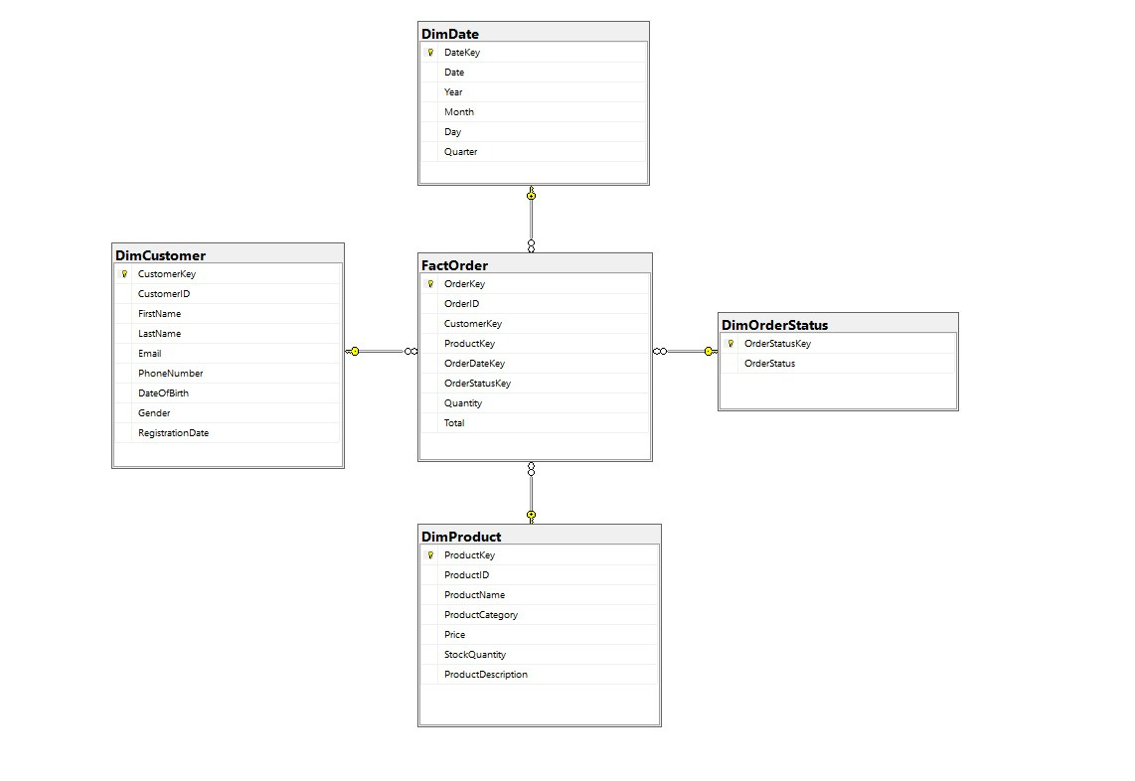
2. SQL Data Warehouse Implementation
Focus: Setting up a SQL Data Warehouse to centralize customer data from multiple sources for efficient storage and analysis. This warehouse will enable high-performance queries and provide a foundation for reporting and advanced analytics.
Key Message: The SQL Data Warehouse offers an optimized, centralized platform for managing large-scale customer data, ensuring faster data retrieval and improved analytics performance.

Slide 15

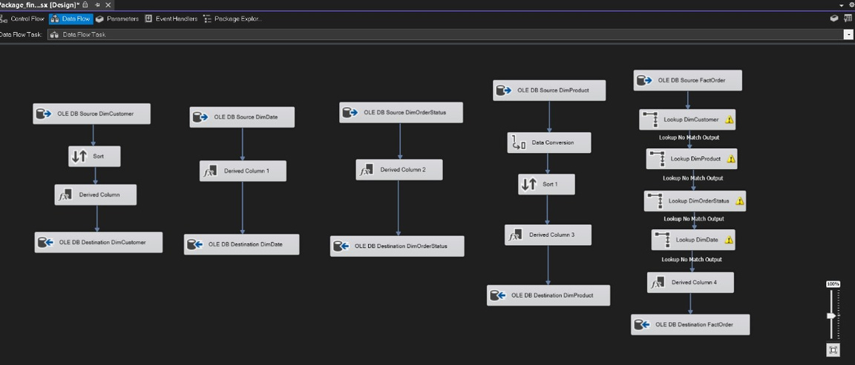
3. Data Integration
Focus: Extracting, transforming, and loading (ETL) data from various sources into the data warehouse, including customer interactions, transactions, and demographic data.
Key Message: Seamless data integration from diverse sources into a unified data warehouse allows for comprehensive customer data management, making all relevant data readily available for insights.

Slide 16
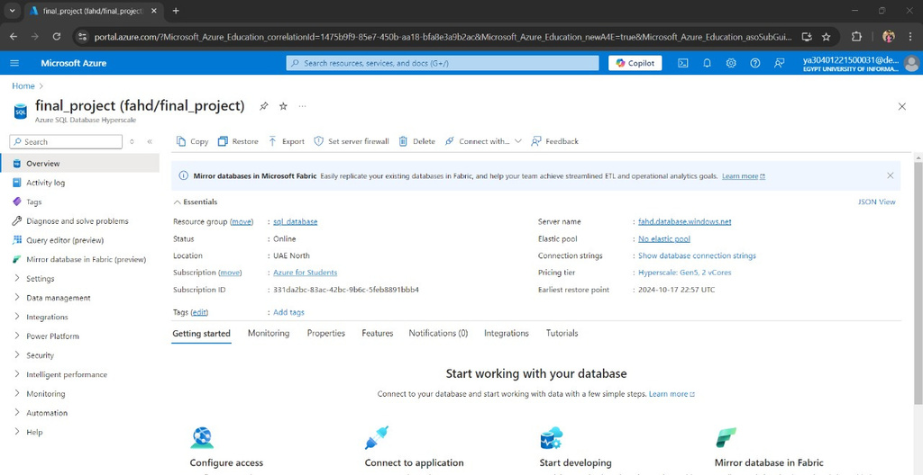
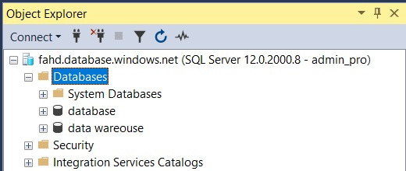
Data AZURE Studio
"We have deployed both our database and data warehouse on Azure so that we can access them from anywhere, and they are available to everyone on the cloud. This setup ensures that the data is centralized, scalable, and easily accessible for all team members."

Slide 17

click to access data warehouse BAK and python script for connection:
https://drive.google.com/drive/folders/1BrLsxFbHRoFPytXExsmmiNeaidO40jBt?usp=sharing

Slide 18
Week 3

Slide 19

Sales Forecasting with ARIMA Model
Objective: To forecast total sales using historical data, performing data ingestion from SQL Server, exploratory data analysis, ARIMA modeling, and deploying the forecast model via an API using Streamlit.
Technologies Used: Python, SQL Server, Pandas, Matplotlib, ARIMA (from statsmodels).

Slide 20
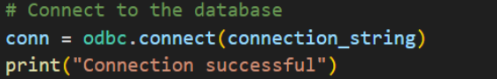
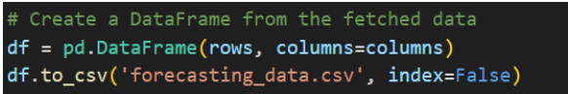
Data Ingestion Process from SQL Server
Used pypyodbc to connect to the SQL Server using connection string.
Queried SalesForecastingData table to retrieve the historical sales data.
saved the fetched data to .csv file for further processes

Slide 21
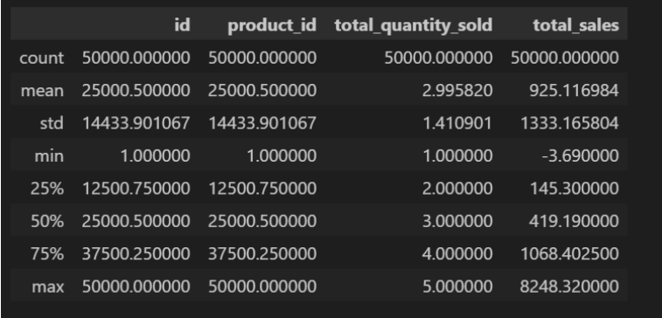
Exploratory Data Analysis (EDA)
Dataset Shape: (50,000 rows, 6 columns)
No Missing Values: There are no nulls in the dataset.
Data Description:-
Total Quantity Sold:
Mean: 2.99 units
Standard Deviation: 1.41 units
Range: 1 to 5 units
Total Sales:
Mean: $925.12
Standard Deviation: $1333.17
Range: -$3.69 to $8248.32

Slide 22
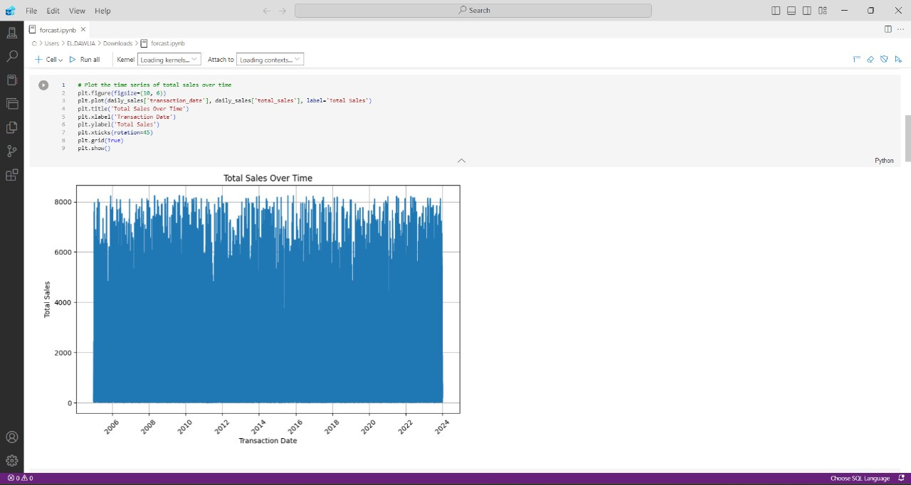
Exploratory Data Analysis (EDA)
Total Sales Over Time: The time series plot shows how the total sales have fluctuated over the recorded period.

Slide 23
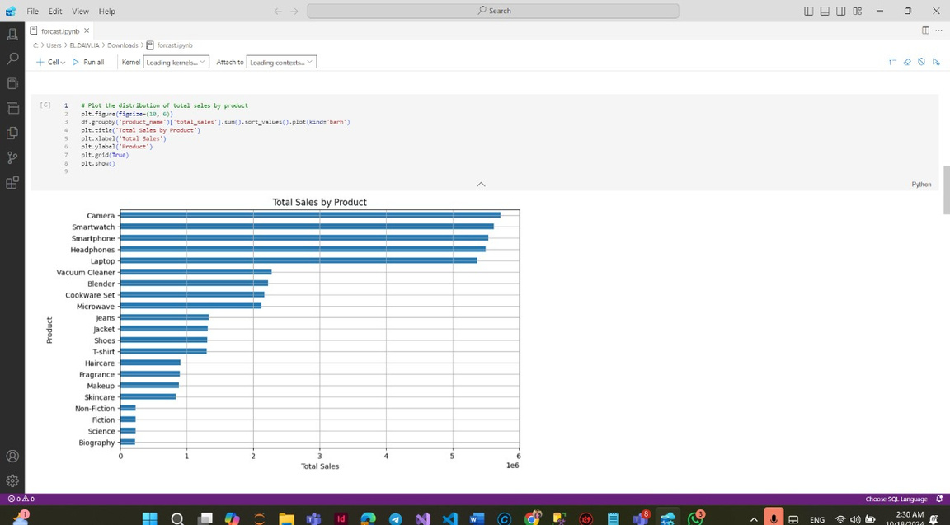
Exploratory Data Analysis (EDA)
Total Sales by Product: A bar chart displays the cumulative sales for each product, helping identify the best-selling products.
Top-Selling Products:
Camera followed closely by Smartwatch and Smartphone.
Middle-Tier Products:
Products like Vacuum Cleaner, Blender, Cookware They still contribute a fair amount but lag behind the top electronic item
Least-Selling Products:
The least-selling products are NonFiction, Fiction, Science, and Biography books,

Slide 24
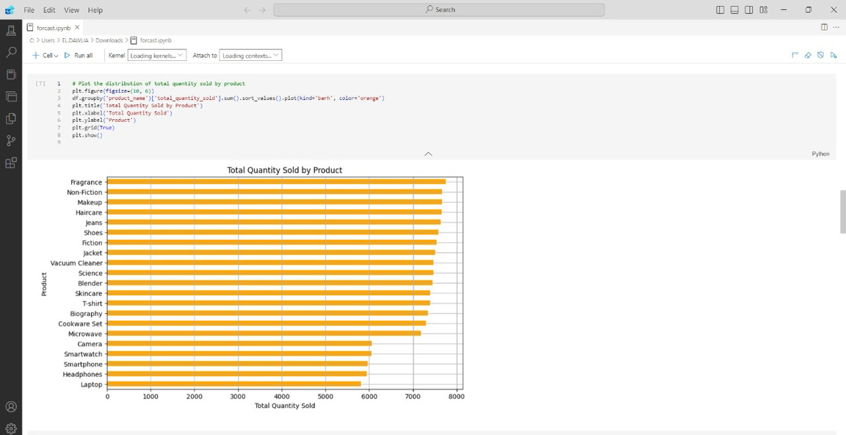
Exploratory Data Analysis (EDA)
Total Quantity Sold by Product: This chart shows the total units sold for each product, giving a clearer picture of product popularity.
Top Quantity Sellers: Products like Fragrance, Non-Fiction, and Makeup lead in total units sold,
Moderate Sellers: Electronics like Smartwatch, Smartphone, and Headphones
Lower Volume: Products such as Cookware Set, Microwave, and Biography have lower quantities sold

Slide 25
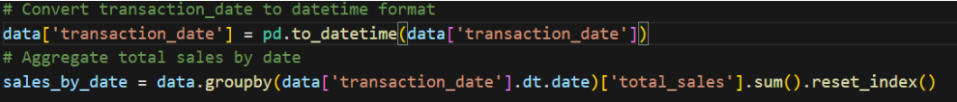
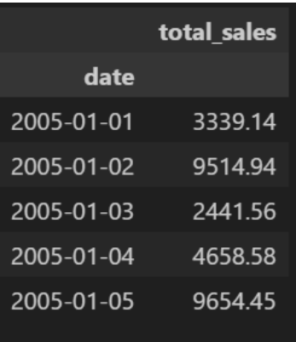
Preparing Data for Forecasting
Converted transaction_date to a datetime format.
Aggregated total sales by date and resampled the data to a monthly frequency to ensure consistency.
Final shape for the data is total sales by month

Slide 26
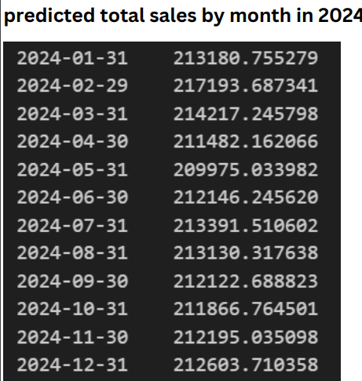
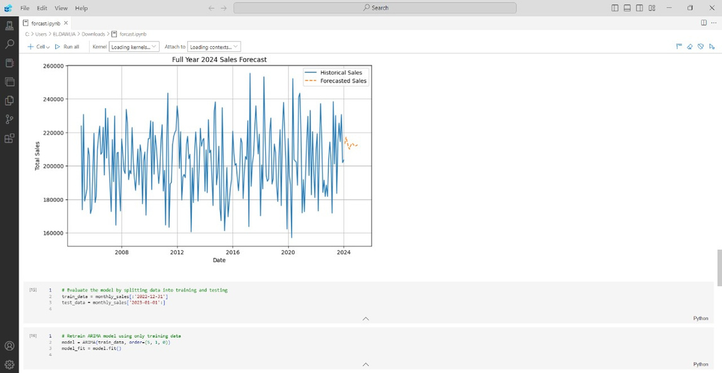
Sales Forecasting Using ARIMA Model
Model Selection:
Trained the ARIMAmodel.
Forecasting: The model was used to forecast sales for the next 12 months, providing a projection of future sales based on historical data.

Slide 27
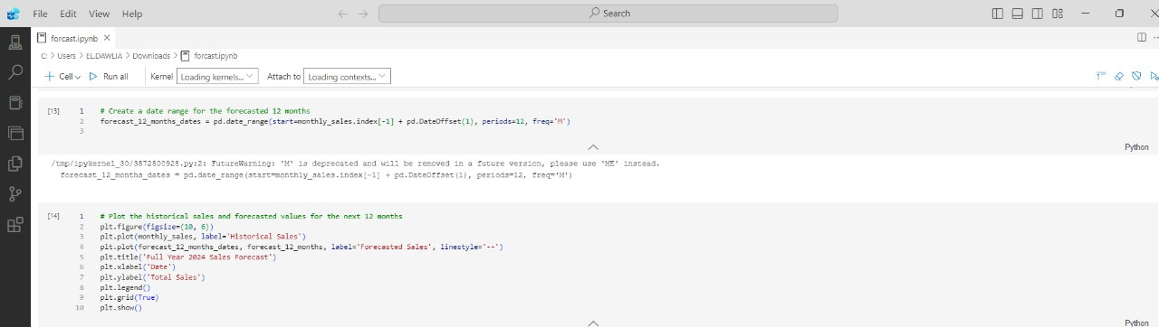
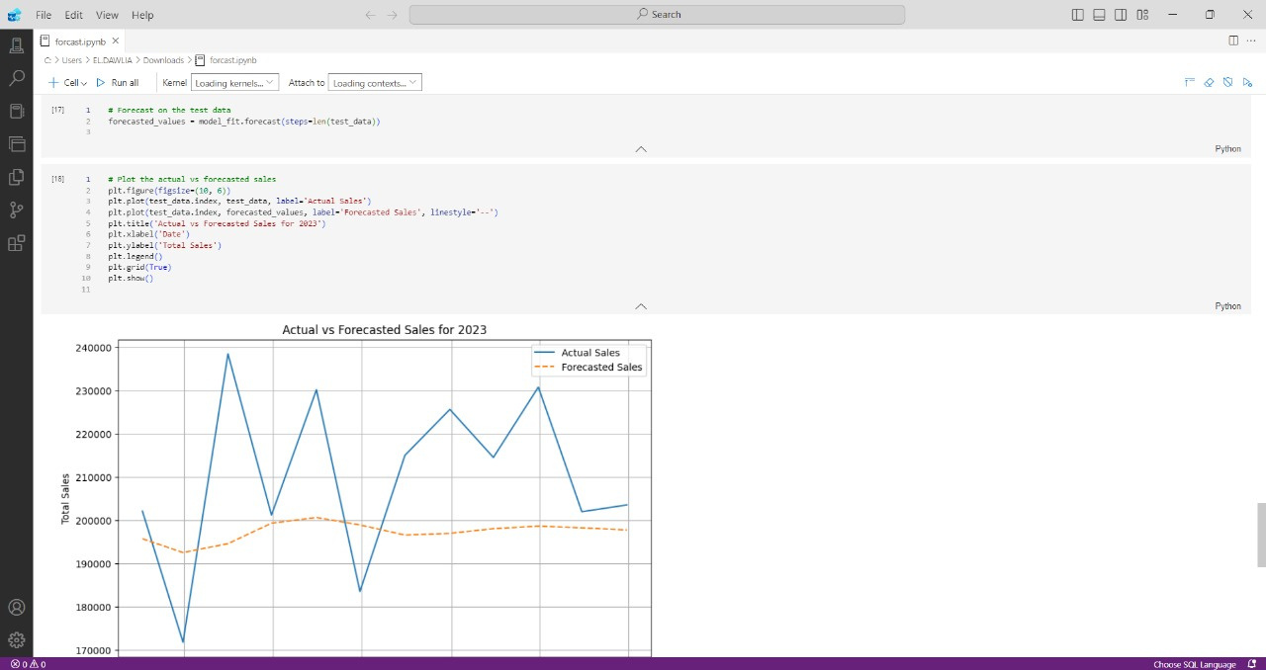

Slide 28
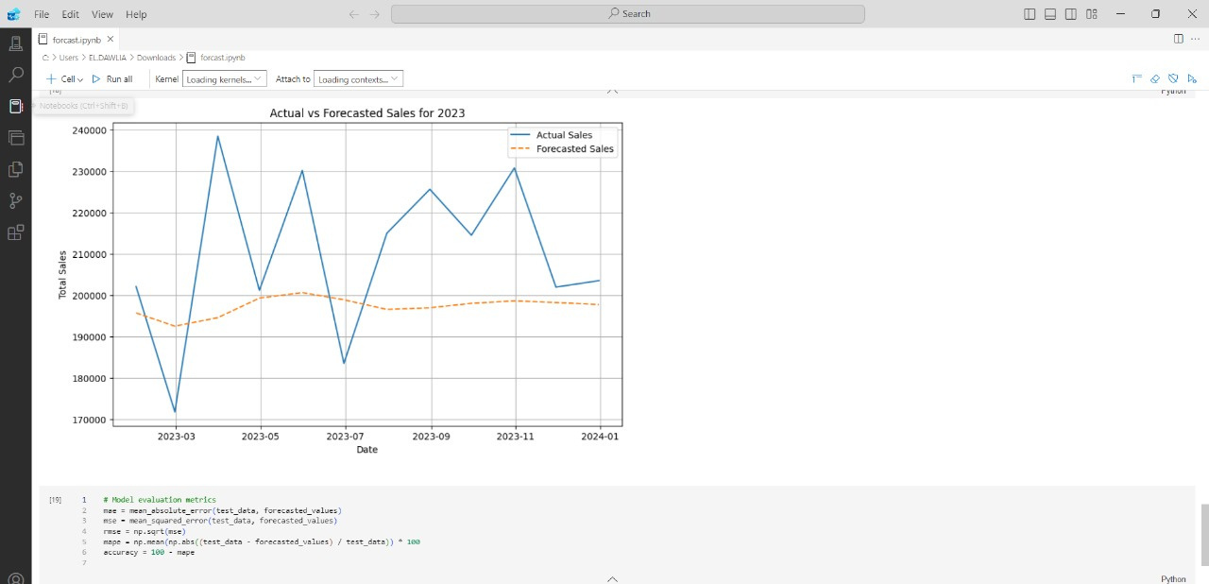
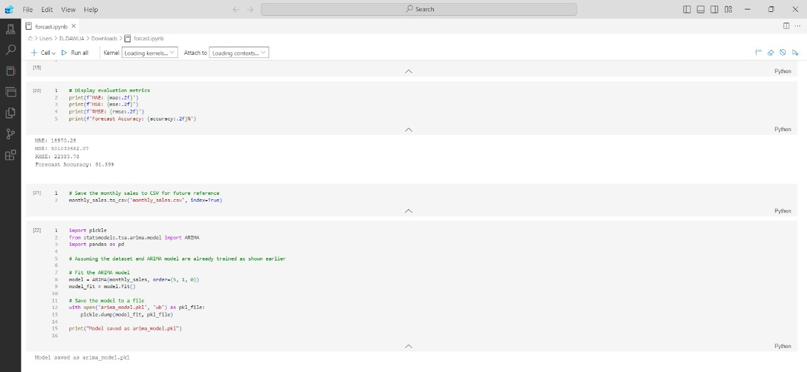

Slide 29
click to access all scripts for this week:
https://drive.google.com/drive/folders/1Y61cepz_15uu9LEhE1LbgJb4flx9dpoo

Slide 30
Week 4

Slide 31

1. MLOps Implementation with Streamlit
Focus: Implement MLOps using Streamlit to create a user-friendly web interface that allows users to interact with machine learning models in real-time. Streamlit makes it easy to track model predictions and provide an interface for non-technical stakeholders.
Key Message: Streamlit simplifies the MLOps process by allowing rapid development of interactive web applications, providing easy access to model outputs, and facilitating real-time predictions without complex infrastructure.

Slide 32
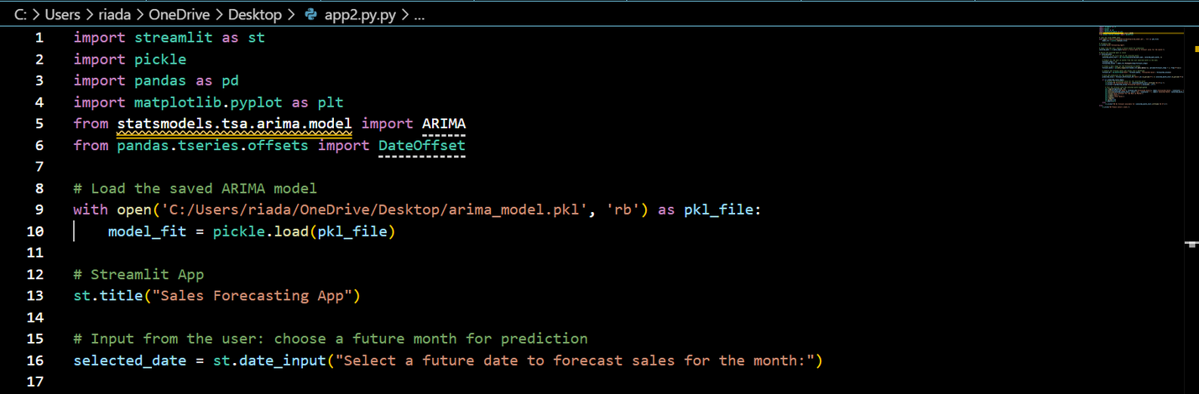
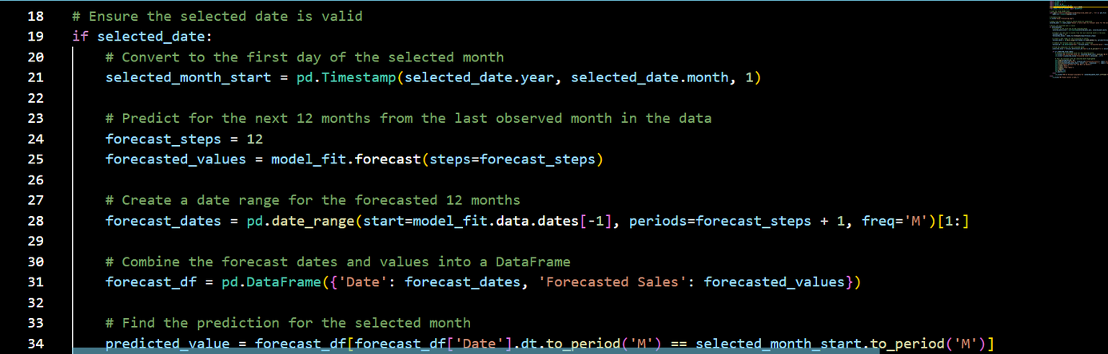
1. MLOps Implementation with Streamlit

Slide 33
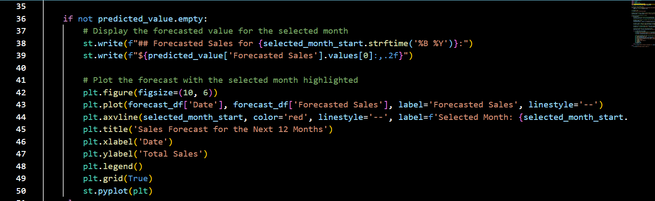
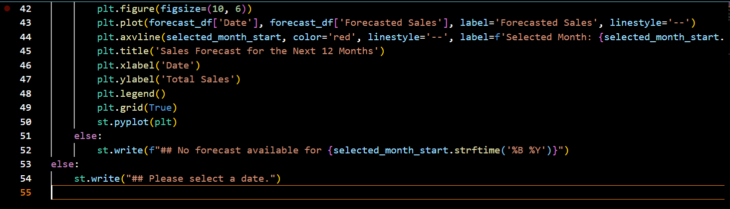
1. MLOps Implementation with Streamlit

Slide 34
2. Model Deployment
Focus: Deploy the machine learning model for scalability or through Streamlit, allowing for direct user interaction with the predictive model via a web app.
Key Message: With Streamlit, deployment is quick and simple, making it possible for businesses to utilize real-time machine learning insights through a customizable, accessible web interface.

Slide 35
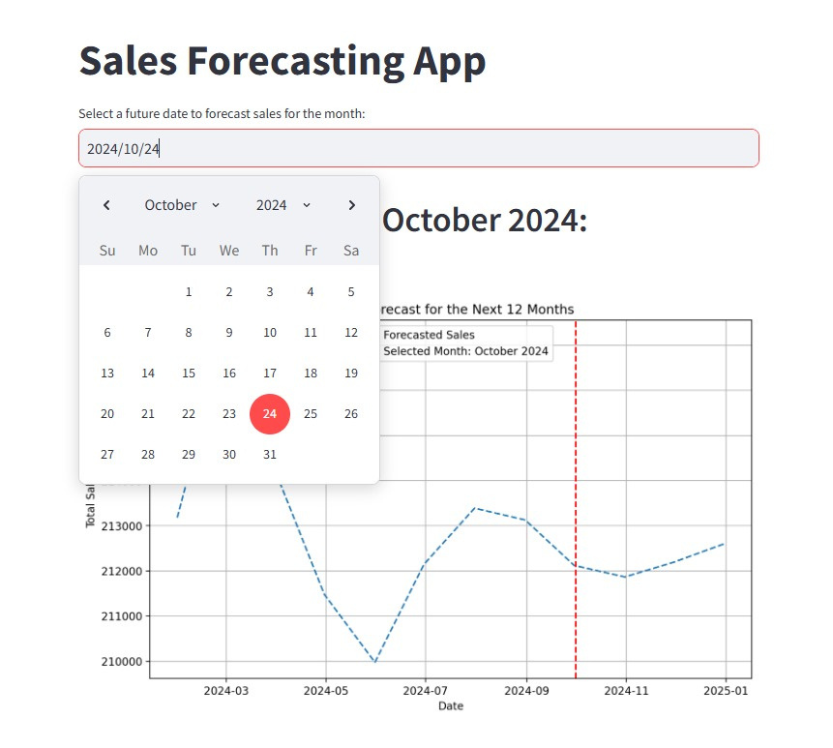
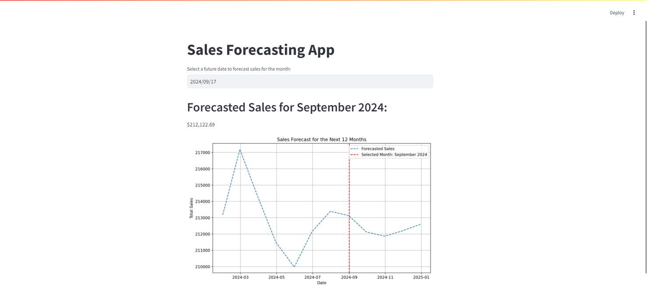
forecasting App

Slide 36
click to access all scripts for this week:
https://drive.google.com/drive/folders/1oigQKjJRxikK9zLUU1y54oEWcOQI5q_N?usp=sharing

Slide 37

Final Report
https://drive.google.com/drive/folders/1aLpJENRb3C7TvgaBEvZrivxM3wqu7mQx?usp=drive_link

Slide 38






TEAM MEMBERS
• Youssef Bahgat Ahmed
• Esraa Mohamed Badea
• Mervat kamel Khalil
• Wafaa Rafek Shawky
• Yara Adel Elshamly
• Mennatullah Mohamed Mahrous
click any photo to check linkedin

Slide 39

................
PRESENTATION - 2024
THANK YOU
................

